Slide 1



Slide 2


WRAD Objectives
1 Raise Awareness
2 Highlight the Global Need
3 Educate
4 Recognize Radiotherapy Professions

Slide 3

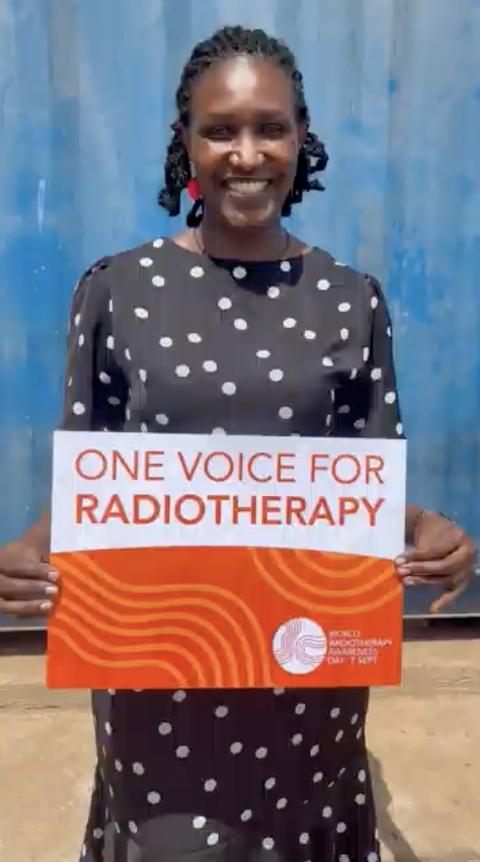
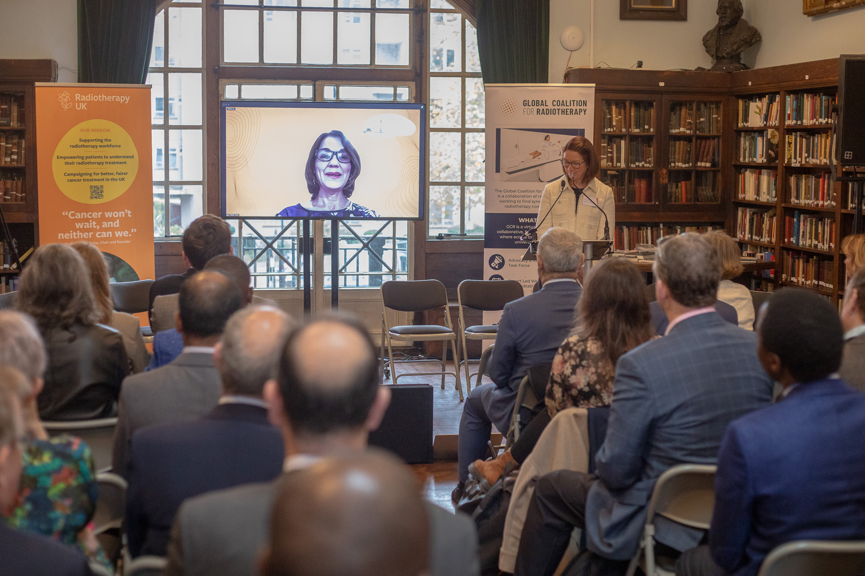
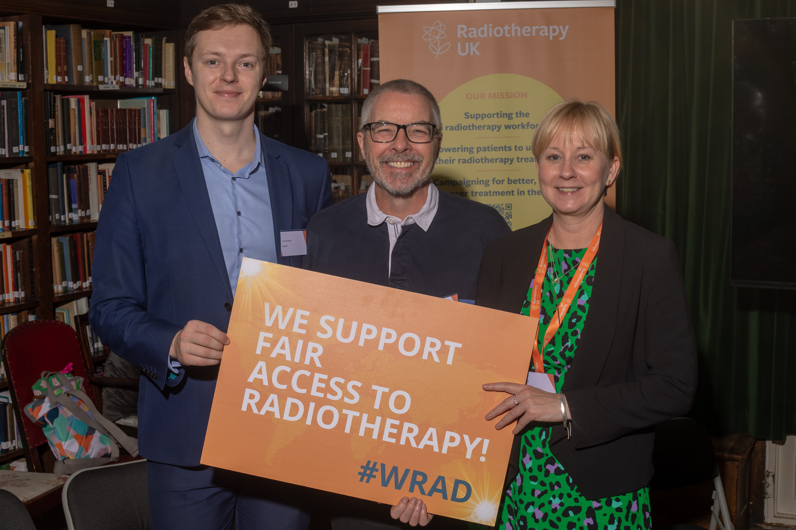
WRAD Planning Events

Slide 4

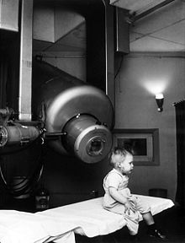
WRAD Date
7th September
Launching 2025
Notes:
September 7th was the first day a person with cancer was treated on a dedicated clinical linear accelerator in London, UK.

Slide 5
Who?
1 Patient groups
2 RT societies
3 Interprofessional
4 Industry partners/sponsors

Slide 6

Theme & Campaign Messages
Theme: One Voice for Radiotherapy
One Voice for every patient to have access to modern radiotherapy
One Voice for curing cancer & easing suffering with radiotherapy
One Voice for raising awareness of radiotherapy as a safe, effective & advanced treatment
One Workforce Voice for well-educated & skilled radiotherapy teams
One Voice to make lasting change for cost-effective global cancer control through radiotherapy

Slide 7
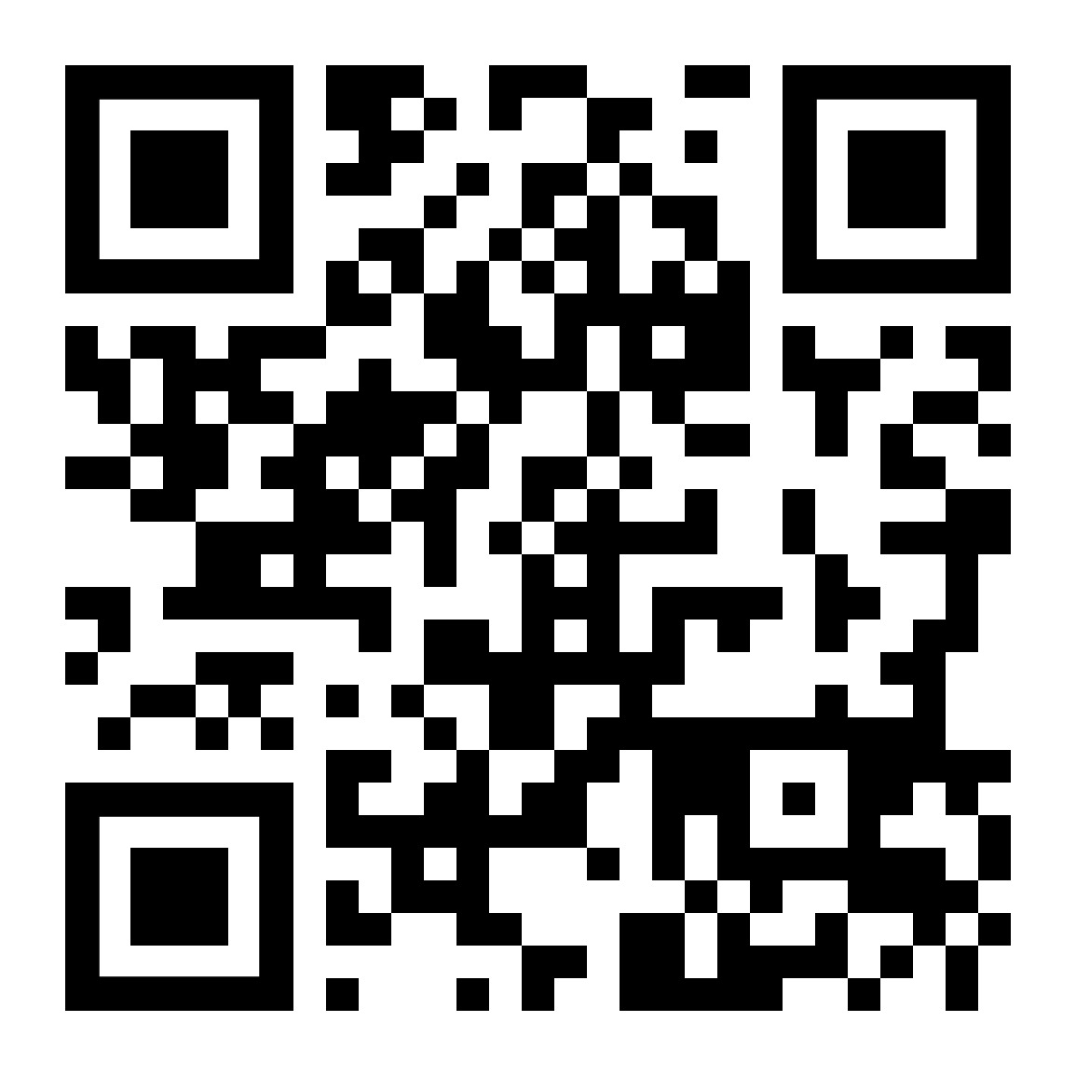





Website and Social Media
www.worldradiotherapy.org
X - @WorldRTDay
Facebook - World Radiotherapy Awareness Day
LinkedIn - World Radiotherapy Awareness Day
Instagram - @worldradiotherapyawarenessday
YouTube - @WorldRadiotherapyAwarenessDay
#WorldRTDay #WRAD #OneVoiceForRadiotherapy

Slide 8
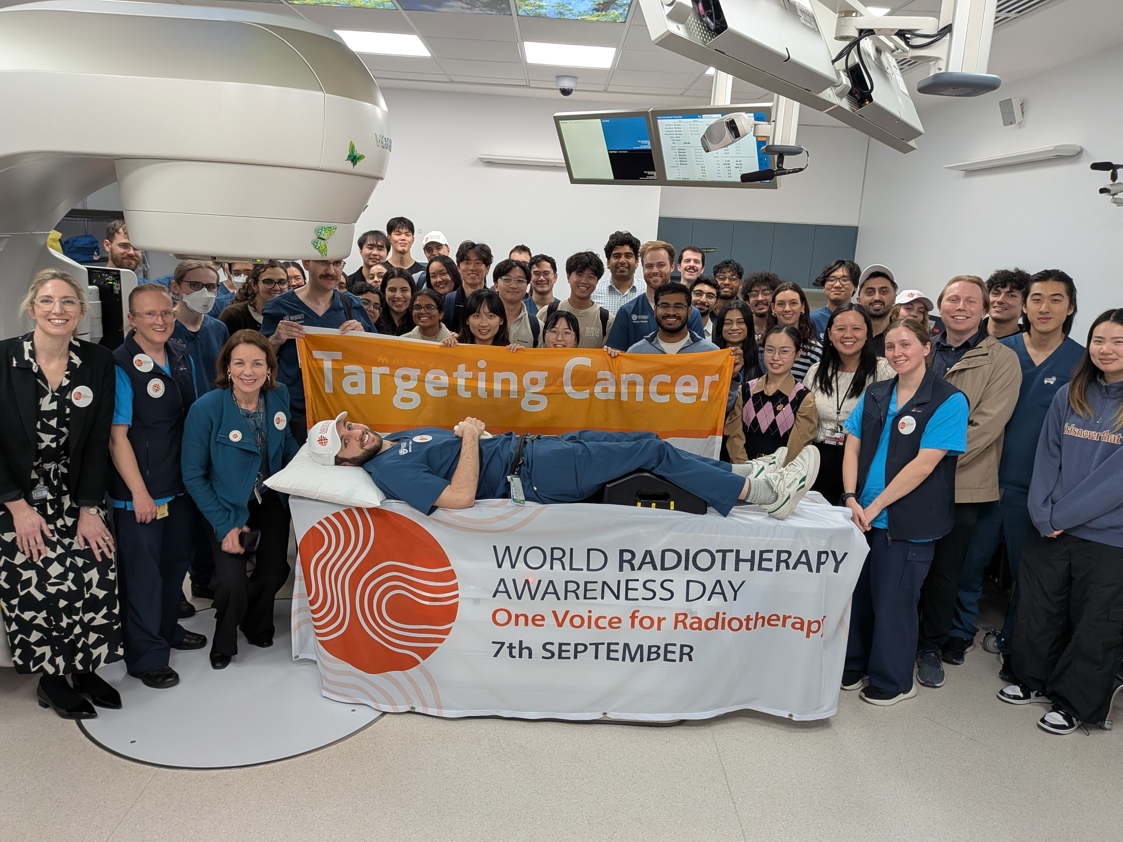
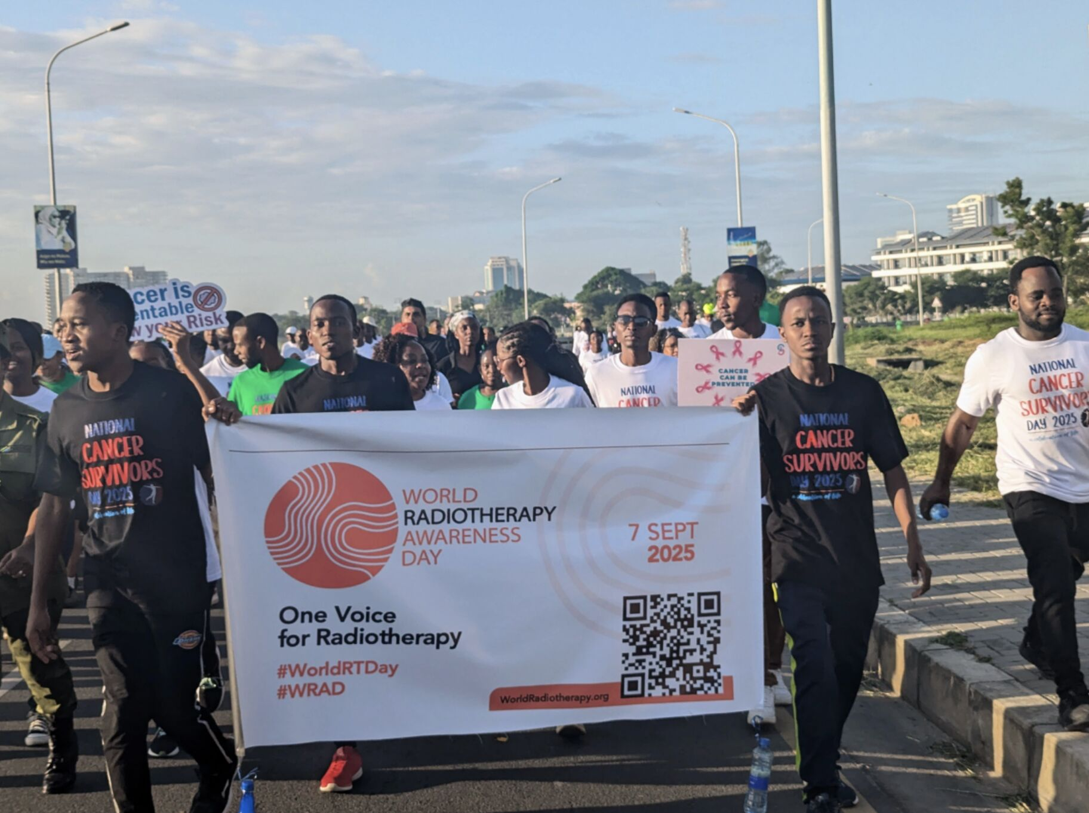
WRAD Launch Events
Send us your event information through a form on our website.

Slide 9
WRAD Calls to Action
1 Join us as a partner; follow our socials
2 Promote through your networks, media
3 Link our website, newsletter articles
4 Events – parliamentary, society meetings

Slide 10
Thank you for supporting World Radiotherapy Awareness Day!

