Slide 1


Notes:
Thank you for the opportunity to talk about WRAD
My name is….
Background and link to WRAD
Radiotherapy is vital for curing cancer, alleviating symptoms, and improving a patient’s quality of life.
Access to radiotherapy is directly linked to improved survival for many cancers. Radiotherapy is also a highly cost-effective cancer treatment. However, around the world, significant regional and national disparities in access to radiotherapy persist.
Reasons include inadequate services, geographical barriers, insufficient workforce and a lack of awareness of modern radiotherapy.
One way to overcome these disparities is to create a radiotherapy awareness day to provide a platform for the global radiotherapy community to join together and direct attention on radiotherapy to the public, media and governments

Slide 2


Recap on WRAD Objectives
1 Raise Awareness
2 Highlight the Global Need
3 Educate
Recognize Radiotherapy Professions
Notes:
The WRAD objectives are to:
Raise awareness about the role of radiotherapy for cancer treatment.
Highlight the need to improve access to radiotherapy, which is a major issue globally
Educate healthcare professional, patients and policy makers about the importance of radiotherapy
Recognise the importance of the radiotherapy professions including and the need for an adequate and skilled workforce
We believe that a recognised World Day will amplify our efforts to address these challenges globally.

Slide 3

Campaign Messages
Theme: One Voice for Radiotherapy
One Voice for every patient to have access to modern radiotherapy
One Voice for curing cancer & easing suffering with radiotherapy
One Voice for raising awareness of radiotherapy as a safe, effective treatment
One Workforce Voice for well-educated & skilled radiotherapy teams
One Voice to make lasting change for cost-effective global cancer control through radiotherapy
Notes:
WRAD overarching theme is “One voice”.
This captures the fact that WRAD is truly a global movement, where the whole rad onc community, the world over has joined forces to help people living with cancer, no matter where they live.
We are testing out translations to get the same meaning in other languages, and these are now on the WRAD website.

Slide 5
Notes:
.

Slide 6






Social Media
www.worldradiotherapy.org
X - @WorldRTDay
Facebook - World Radiotherapy Awareness Day
LinkedIn - World Radiotherapy Awareness Day
Instagram - @worldradiotherapyawarenessday
YouTube - @WorldRadiotherapyAwarenessDay
#WorldRTDay #WRAD #OneVoiceForRadiotherapy

Slide 7
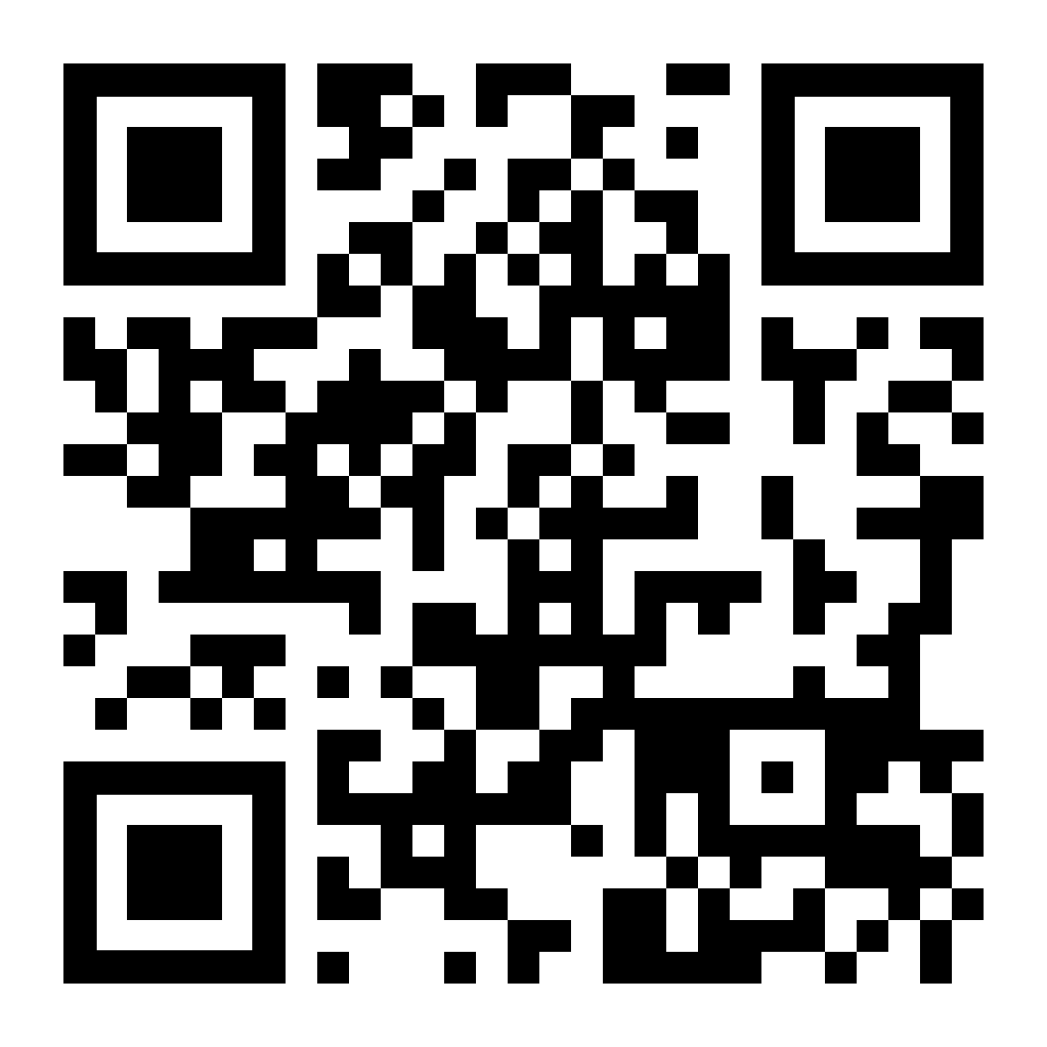
Thank you for supporting World Radiotherapy Awareness Day!

